Slide 1
HOSPITAL MANAGEMENT
Jayalakshmi Vaidyanathan

Slide 2
INTRODUCTION
Data Management is one of the major challenges in Healthcare
Hospitals struggle to store and manage the patients records and images from various tests and surgeries carried out
Medical Reports are the most intensive and diverse in Hospital Management Information System

Slide 3
Use Cases
Patient Details
Users: Doctor,Patient, Admin
Diagnosis Details
User: Doctor
Billing Management
Admin
Lab Data Management
Lab Technician, Doctors,Patients

Slide 4
Users
Doctor
Patient
Technician
Admin

Slide 5
SQL Vs NoSQL
Patient Details - SQL
Diagnosis Details - SQL
Billing Management - SQL
Lab Data Management - NoSQL

Slide 6
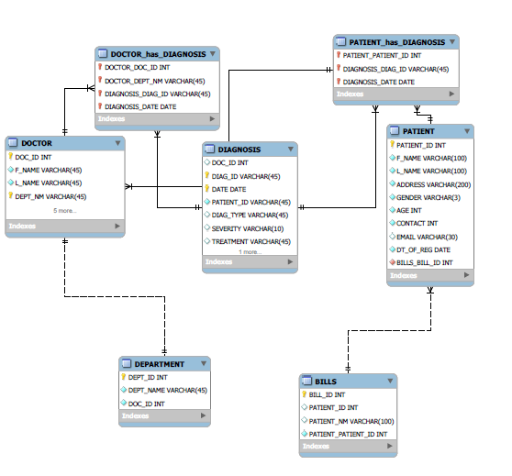
SQL - UML

Slide 7
Data Base Design
Tables: Doctor, Patient, Diagnosis, Department, Bill
Views: VW_Doc_consultn
Stored Procedure: Business Matrices

Slide 8
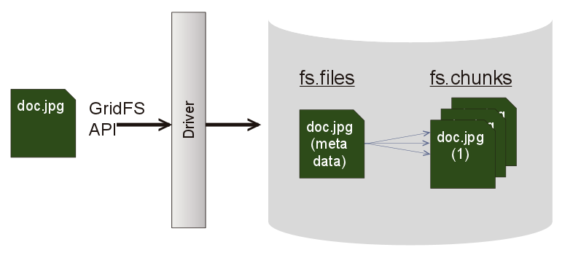
Mongo Design – Lab Report Management
Mongofile Utility
GridFS - For files more than 16MB
fs.files
Fs.chunks – each chunk of size 255KB

Slide 9
Business Matrix

Slide 10
Business Matrix

Slide 11
Business Matrix

Slide 12
What was the hardest part of this project?
Deciding between SQL Vs NoSQL
Populating Unstructured data
Implementing the GridFS and mongofile

Slide 13
What problems did you run against in this project?
Designing the management system
Framing stored procedures
Using Mongofiles feature

Slide 14
How did you solve these problems?
Referenced SQL tutorial for stored procedure
MogoDB manual
Discussed with peer students who had some knowledge on DBMS

Slide 15
If you were to do this project again
Improvise on the design
Include analysis part in NoSQL
Expand the scope to Drug Department

Slide 16
Thank You!

